Slide 1
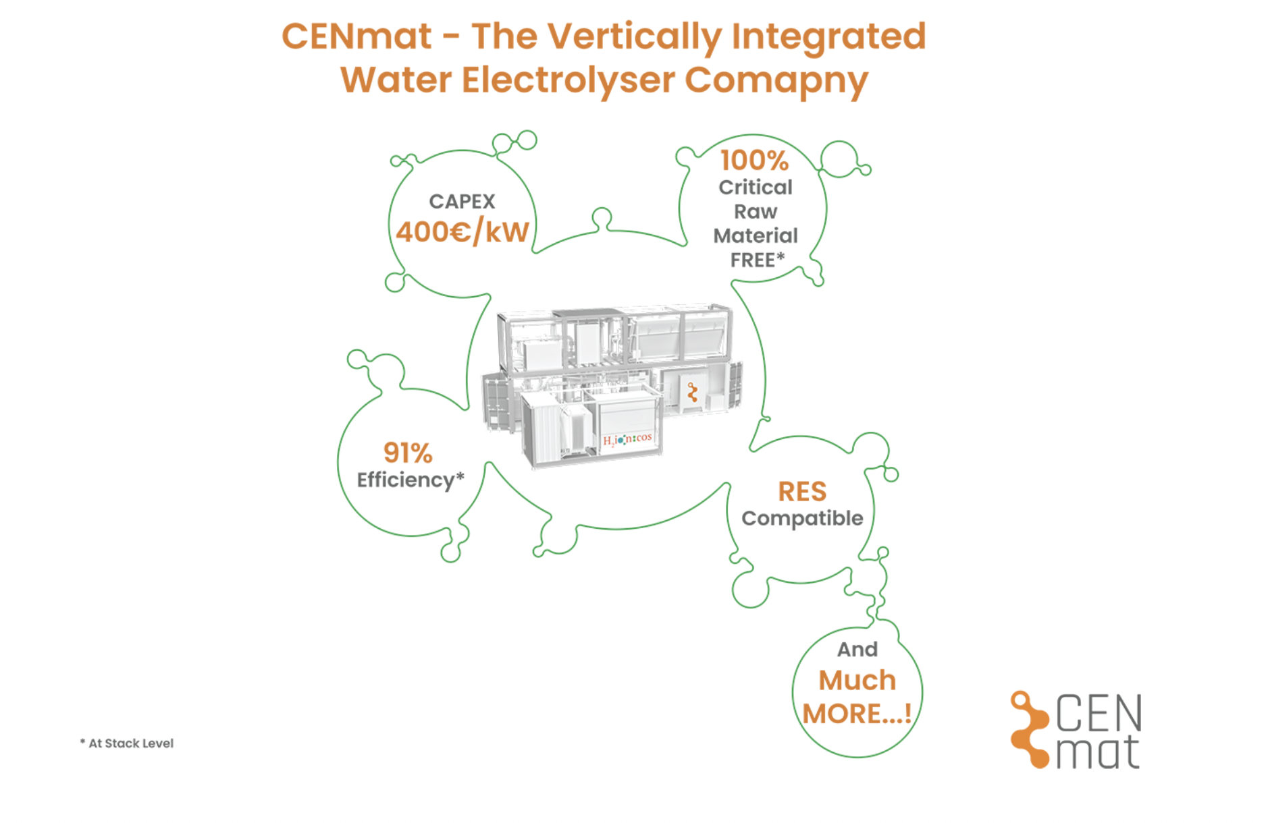


Sankalp Saoji Sijia Yu

Slide 2
Company
We are CENmat!
Also, known as Cutting-Edge Nanomaterials
Founded in 2019
A spin-off from the German Aerospace Center
Headquartered in Waldenbuch, Germany with labs and some offices in German Aerospace Center, Stuttgart, Germany
An innovative and fast growing vertically integrated electrolyser company
Offers a broad range of services on materials, components, and systems for energy storage and conversion technologies such as electrolysis, fuel cells, and batteries
Delivers the most economical, efficient, and critical raw material free electrolyser for affordable and real green hydrogen production
Current Revenue - 25M USD
Funding - 500M USD

Slide 3
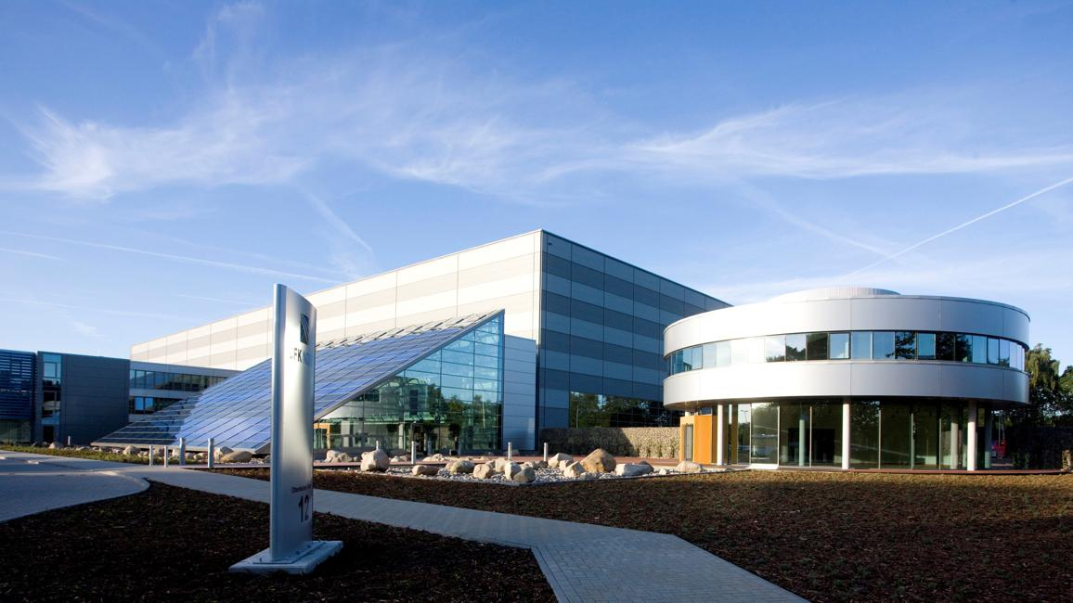

Slide 4
Patent
US8013269B2
Induction plasma synthesis of nano-powders
Current Assignee - Tekna Plasma Systems Inc
Process and apparatus for synthesizing nano-powders is presented
Process for the synthesis of nano-powders of various materials such as metals, alloys, ceramics and composites by induction plasma technology, using organometallic compounds, chlorides, bromides, fluorides, iodides, nitrites, nitrates, oxalates and carbonates as precursors is disclosed
Process comprises feeding a reactant material into a plasma torch in which is generated a plasma flow having a temperature sufficiently high to yield a superheated vapor of the material; transporting said vapor by means of the plasma flow into a quenching zone; injecting a cold quench gas into the plasma flow in the quenching zone to form a renewable gaseous cold front; and forming a nano-powder at the interface between the renewable gaseous cold front and the plasma flow

Slide 5
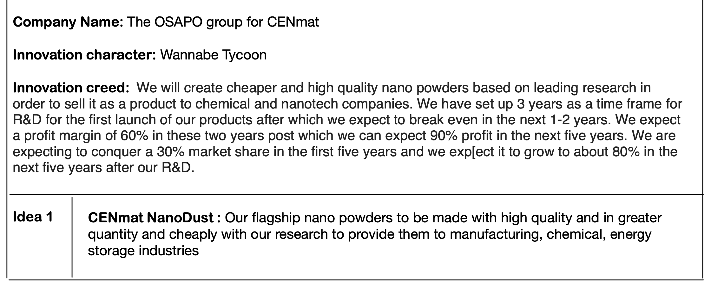
Idea

Slide 6
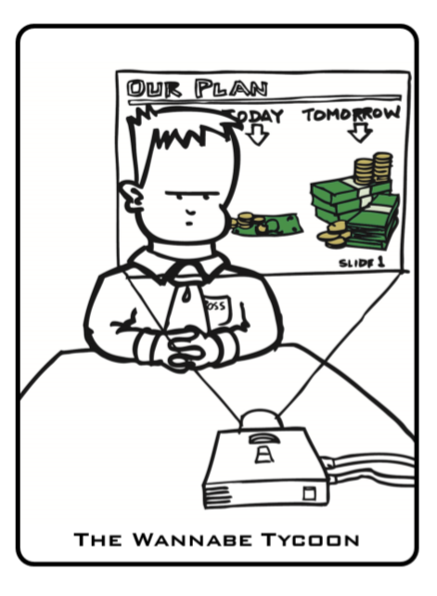
Innovation Creed
We are Wannabe Tycoons!
We want to revolutionise the industry
We have to solve some problems we are facing to get ahead of the competition
We really need to have a breakthrough!
Working in the OSAPO Division of the company
Rights to a patent where our research contributed to creation of nano-powders in a specialized and more efficient way
Nano-powders from our company go out to the market in the name of NanoDust – our flagship product
Product sold to chemical, agriculture and research facilities and collaboration with giants like BASF and Arkema

Slide 7
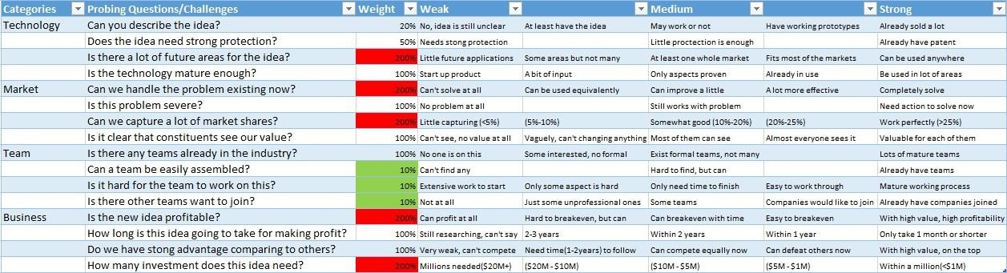
Updated filtering
From full filter...

Slide 8
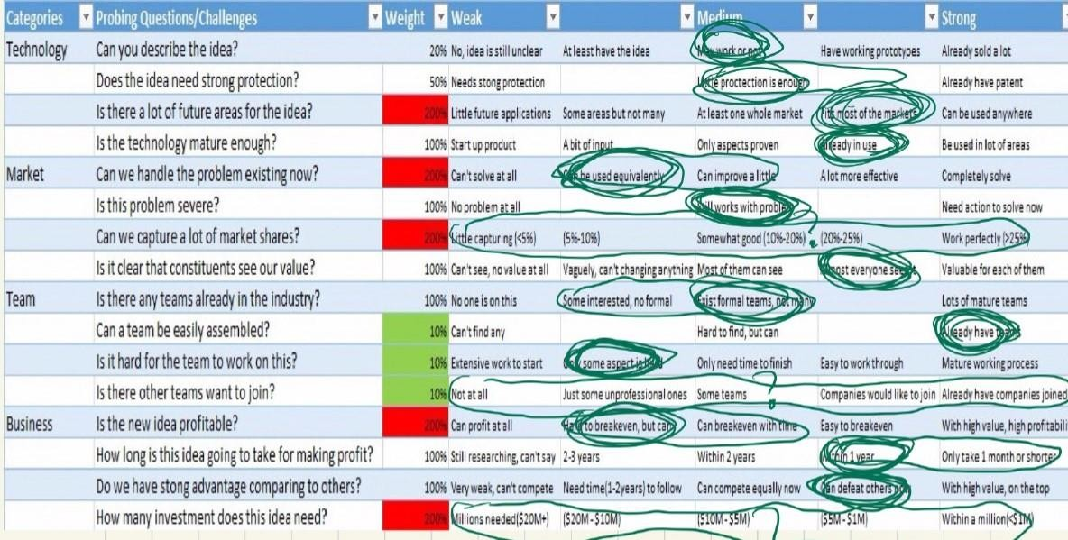
Updated filtering
To filtering the idea!

Slide 9
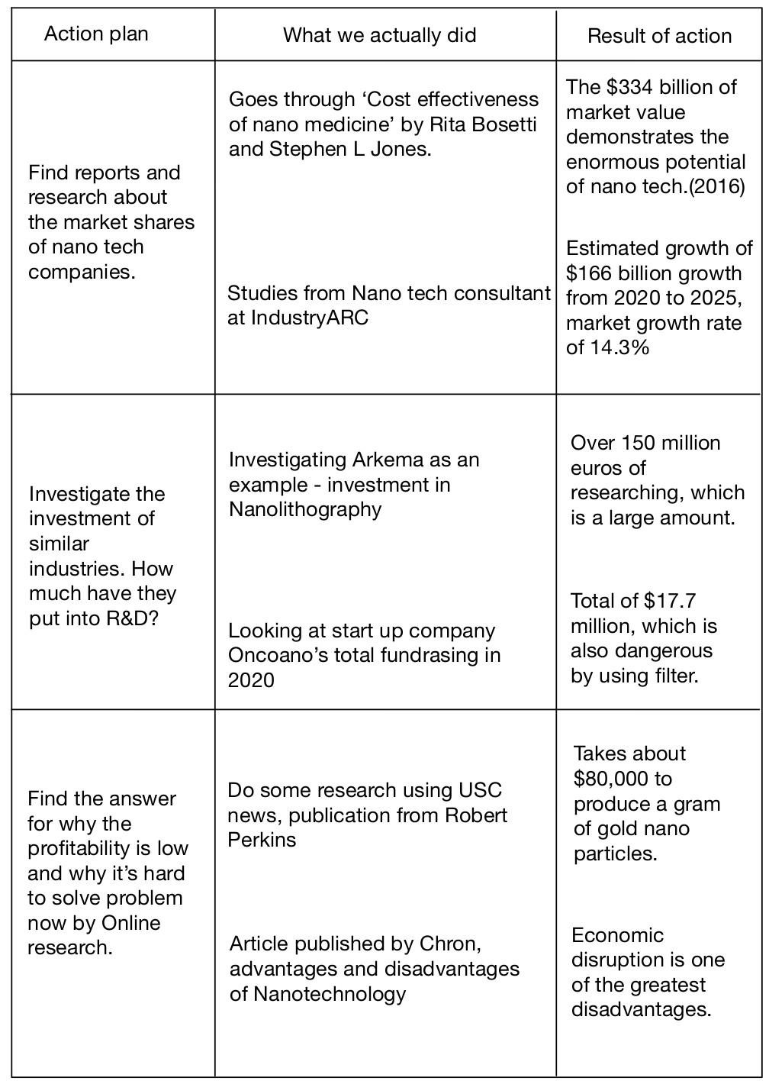
Action Plan and Results
Investigational plans...
that we already completed!

Slide 10
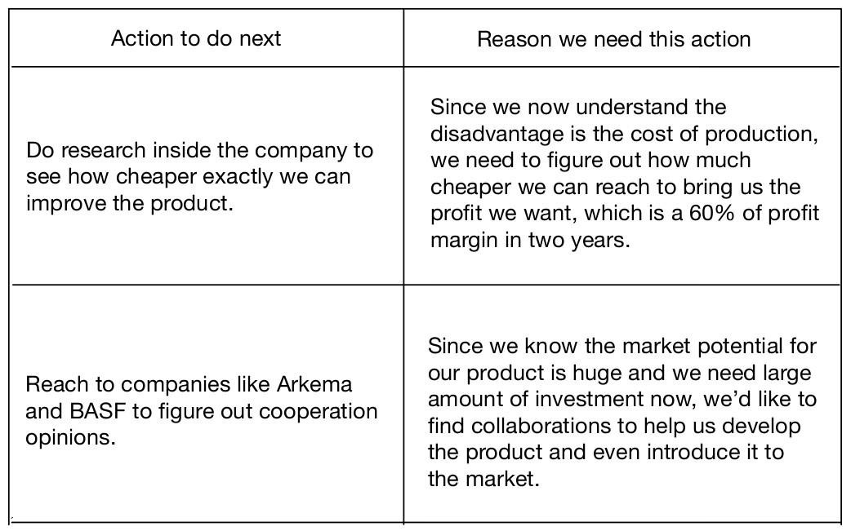
Action Plan – Next Steps
Investigational plans...
to do next!

Slide 11
Risks
We set time for R&D, we hope no one beats us in this period with a superior product
Costs associated could be larger than we thought – as is the case with most first products
Delay in the release of our first products due to unforeseen reasons
Funding cut due to financial troubles in investors’ organizations

Slide 12
Decision
As per our action plans, we will see whether the revenue exceeds our cost. If it does, we will have profit and we will continue
But if the action plan for a later time period shows that the profit is not large enough or revenue is even smaller than the cost, than we will recommend to stop this idea

Slide 13
THANK YOU

